Slide 1
Creating Unsigned iOS XCArch
Ted Alonso

Slide 2
Why Create Unsigned XCArch
Customer does not want to share their Apple Certificate to sign their custom app
We can’t use our own Apple Certificate due to licensing limitations
Solution:
Create Unsigned XCArch with customer desired bundle id
Have customer sign it with their certificate/distribution profile

Slide 3
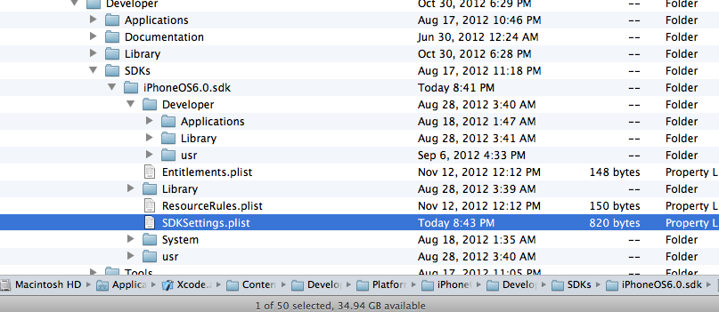
Modifying XCode
Start Terminal
cd /Applications/Xcode.app/Contents/Developer/Platforms/iPhoneOS.platform/Developer/SDKs/iPhoneOS6.0.sdk
Go to the same directory in the Finder

Slide 4
Modifying XCode-Cont
In the terminal type the two following commands:
sudo chmod 755 .
sudo chown <your login id> .
In the finder right mouse click the file SDKSettings.plist and Open with your favorite GUI plain text editor (vi and emacs don’t quite work). I use TextWrangler.

Slide 5
Modifying Xcode-Cont-2
Change
<key>CODE_SIGNING_REQUIRED</key>
<string>YES</string>
To:
<key>CODE_SIGNING_REQUIRED</key>
<string>NO</string>
Save file
In the Terminal Window execute
chown root SDK*.plist
chown root .
Restart XCode

Slide 6
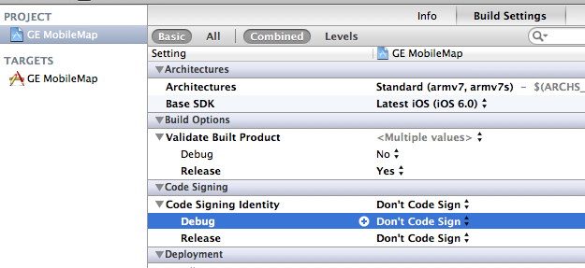
Turn off Code Signing in Xcode

Slide 7
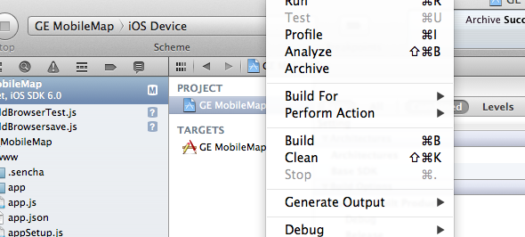
Create XCArch

